Slide 1



WEBINAR
MAY 2026
The Missing Link In Tax Planning
Discover how business valuations influence tax outcomes — and how early planning can unlock better results for your clients.
PRESENTED BY
Peter Johnson
MAY 2026

Slide 2
PART 1 · THE FOUNDATION
Small Business CGT Concessions
Often worth more than every income tax cent the business will ever pay. But almost always too late if you wait until the sale.
CGT CONCESSIONS

Slide 3

03
WHY IT MATTERS
Often Worth More Than Every Tax Cent.
CGT concessions can deliver a bigger tax outcome at sale than the income tax paid over the entire life of the business.
THE BOTTOM LINE
But it is almost always
A successful concession can wipe out the entire CGT on a business sale.
.
too late to consider them after the sale
They need to be looked at
every year
A missed condition can leave the same liability fully exposed.
— even just a cursory glance.
Eligibility hinges on facts that compound over time. Miss a year, miss the planning window.
The difference is when you start looking.
The Missing Link In Tax Planning · May 2026
© 2026 BVO · AdvisersDigest.com.au

Slide 4
04
ELIGIBILITY
Four Routes In, Plus The Active Asset Test.
To access the concessions you must satisfy one of:
AND — ALWAYS
A. You are a CGT Small Business Entity.
You must also satisfy the Active Asset Test.
OR
Turnover and net assets are tested every single year — including you, your affiliates, and your connected entities.
B. You satisfy the $6M Maximum Net Asset Value test.
OR
C. You are a partner in a partnership that is a CGT SBE, and selling an asset of the partnership.
Aggregation is the trap.
OR
D. An entity or partnership connected to you is a CGT SBE, and the asset is used by that entity.
The Missing Link In Tax Planning · May 2026
© 2026 BVO · AdvisersDigest.com.au

Slide 5
05
SECTION 152-35
The Active Asset Test.
A CGT asset satisfies the Active Asset Test if —
CRITICAL DISTINCTION
15 years or less: the asset was an active asset for a total of at least half of the period specified in s.152-35(2).
The test is not based on the asset's status when it is sold.
OR
It is based on the asset's status across the whole ownership period .
More than 15 years: the asset was an active asset for a total of at least 7.5 years during the period specified in s.152-35(2).
Treat the test as historical, not point-in-time.
The Missing Link In Tax Planning · May 2026
© 2026 BVO · AdvisersDigest.com.au

Slide 6
06
SECTION 152-35
What Is An Active Asset?
A CGT asset is also an active asset at a given time if, at that time, you own —
A
share in a company
THE 80% TEST — SUM THE MV OF
that is an Australian resident at that time, or
An
interest in a trust
A
that is a resident trust for CGT purposes for the relevant income year
Active assets
of the company / trust
… and the asset must clear the
80% test
(set out opposite).
B
Financial instruments
inherently connected with the business
C
Cash
inherently connected with the business
80% or more of total assets — or the test fails.
The Missing Link In Tax Planning · May 2026
© 2026 BVO · AdvisersDigest.com.au

Slide 7
PART 2 · THE NET WIDENS
Affiliates & Connected Entities
The single concept that catches more advisers off-guard than any other in the small business CGT regime.
AGGREGATION

Slide 8
08
DEFINITION
Defining An Affiliate.
It is a
conduct-based
IN PLAIN ENGLISH
test — not a relationship test, not an entity test.
An affiliate is someone accustomed to taking your direction in relation to the business.
not automatically
Spouses and children are
affiliates — but they often will be in practice.
Look at the
pattern of decisions
— who actually calls the shots in the business?
The status can change year to year.
Test it annually.
The Missing Link In Tax Planning · May 2026
© 2026 BVO · AdvisersDigest.com.au

Slide 9
09
WHY IT MATTERS
Aggregation: Your Numbers + Theirs.
01
Aggregated turnover is the turnover of you, your affiliates, and your connected entities . It is the test for whether you are a small business entity.
IMPLICATION
A standalone small business can still fail the threshold once an affiliate or connected entity is rolled in.
02
Net assets means the net assets of you, your affiliates, and your connected entities. The MNAV test runs on the combined number.
Most concession failures discovered at the eleventh hour are aggregation failures.
Every test that gates the CGT concessions is an aggregated test — not a standalone one.
2
Annual review keeps you honest.
The Missing Link In Tax Planning · May 2026
© 2026 BVO · AdvisersDigest.com.au

Slide 10
10
WORKED EXAMPLE
Are Peter & Chloe Affiliates?
THE FACT PATTERN
HOW TO AVOID IT
Based on distributions over the last four or so years, Peter is treated as controlling Advisers Digest Trust, Auditmatch Trust, Johnson Family Trust & Johnson Investment Trust .
Aggregation is not destiny — it can be unwound with deliberate steps.
Can we ensure Peter
does not receive 40% of distributions
DISTRIBUTIONS
moving forward?
Re-engineer the trust distribution pattern.
We also need to look at
"control"
and start handing it over.
CONTROL
Transfer real decision-making out of the affiliate's hands.
DOCUMENTATION
Make the pattern observable in the records.
The Missing Link In Tax Planning · May 2026
© 2026 BVO · AdvisersDigest.com.au

Slide 11
PART 3 · THE TOOLKIT
Restructures & Rollover Relief
Reshape the structure now, so the concession landscape works in your client's favour at sale.
RESTRUCTURE
OPTIONS

Slide 12
12
THE LANDSCAPE
What Restructures Are Available?
01
02
Small Business Restructure Roll-Over Relief
Division 122 / 615
The general-purpose tool. Move assets between connected entities without triggering CGT, where the conditions are met.
The classic holding-company insertion and corporate reorganisation rollovers. Long-established, well-understood.
03
04
Demerger Relief
Budget Relief?
Splits an existing business or group into separate, freestanding entities — with relief from the obvious tax cost.
Watch the legislative pipeline — new or expanded relief is regularly flagged. Position now, claim later.
The Missing Link In Tax Planning · May 2026
© 2026 BVO · AdvisersDigest.com.au

Slide 13
13
CONCRETE MOVES
What Are Your Options?
01
Insert a holding company above the existing operating entity — Division 122 / 615.
02
Transfer the goodwill from a company to a trust — 328-G.
03
Transfer the goodwill from an individual to a company or to a trust — 328-G.
04
Transfer goodwill from a company owned by an individual to a company owned by a trust — 328-G.
05
Wait for legislation? — only ever a tactic when paired with positioning today.
The Missing Link In Tax Planning · May 2026
© 2026 BVO · AdvisersDigest.com.au

Slide 14
14
SMALL BUSINESS RESTRUCTURE ROLL-OVER
The Conditions.
You must be a
Small Business Entity
WATCH THIS SPACE
$10M
— aggregated turnover less than
The transfer must be part of a
genuine restructure.
Will any of this change?
Staying in the new structure for three years is deemed a genuine restructure.
The SBRR conditions are under regular review. Treat the rules as today's rules, not tomorrow's.
There must be
no change in beneficial ownership.
For a discretionary trust, an FTE in favour of someone in the same family group is required.
Plan the move on the law as it is. Re-test before settlement.
The asset must satisfy the
rules regarding the asset
.
Depreciating assets and trading stock are transferred at values that produce
no gain or loss
in the transferring entity.
The Missing Link In Tax Planning · May 2026
© 2026 BVO · AdvisersDigest.com.au

Slide 15
PART 4 · THE BVO LENS
Valuation Methodologies
Every concession test, every threshold, every restructure ultimately turns on a number. Where does that number come from?
VALUATION

Slide 16
16
METHODOLOGY 01
Net Tangible Assets Approach.
Where the majority of assets consist of cash or passive investments , or where other methodologies indicate that there is no goodwill —
WHEN TO USE IT
The fallback valuation methodology.
market value
If the business doesn't reliably generate earnings above the return on its tangible assets, there is nothing to capitalise.
All assets and liabilities of the entity are valued at
.
The combined market value forms the basis for the entity's valuation.
The approach is
balance-sheet-led
: it bypasses earnings entirely.
No goodwill → no premium → net assets is the answer.
The Missing Link In Tax Planning · May 2026
© 2026 BVO · AdvisersDigest.com.au

Slide 17
17
METHODOLOGY 02
Discounted Cashflow Valuations.
The value of a business is the Net Present Value of its future net cash flows.
THE FORMULA, SIMPLY
Value = sum of future cash flows, each discounted back to today, plus a terminal value.
The
discount rate
represents the opportunity cost of capital — the expected return investors can obtain from investments having
.
equivalent risk
Two inputs do all the work: the cashflow forecast, and the discount rate.
The model includes a
terminal value
representing the remaining value of all future income beyond the forecast horizon.
Garbage in, garbage out. The assumptions are the answer.
Forward-looking. Cashflow-led. Most defensible where the business has a clear forecast story.
The Missing Link In Tax Planning · May 2026
© 2026 BVO · AdvisersDigest.com.au

Slide 18
18
METHODOLOGY 03
Normalised Earnings.
Before you can capitalise earnings, you must first agree what "earnings" means in the context of a valuation.
THE ADJUSTMENTS
Utilising (predominantly)
historical financial results
OWNER REMUNERATION
we seek to determine —
Restate to commercial market rates.
What would the business earn into the future if it continues to trade under
current conditions
ONE-OFF ITEMS
Strip windfalls, COVID effects, settlements.
with all extraordinary, one-off and non-business transactions removed?
NON-BUSINESS
Remove personal & related-party items.
ACCOUNTING POLICIES
Conform to a market-standard treatment.
The Missing Link In Tax Planning · May 2026
© 2026 BVO · AdvisersDigest.com.au

Slide 19
19
METHODOLOGY 04
The Capitalisation Rate.
The "multiple" you see attached to FME-based valuations is the inverse of a capitalisation rate.
WHAT SITS INSIDE IT
INDUSTRY
A capitalisation rate of 25% equates to a multiple of 4.0× earnings.
Cyclicality, structural pressures, regulation.
1 / 25%
The capitalisation rate is a
distillation of all the risks
FINANCIAL
faced by the business, reduced to a single number.
Leverage, customer concentration, margin volatility.
It must have regard for
real-world sales
evidence and the relative risk of this business against its
peers.
BUSINESS
Owner dependence, key-person, succession risk.
One number, four conversations.
The Missing Link In Tax Planning · May 2026
© 2026 BVO · AdvisersDigest.com.au

Slide 20
PART 5 · IN THE REAL WORLD
328-G In Practice
Two worked examples that show where the rule actually does the work — and where it doesn't.
328-G EXAMPLES

Slide 21
21
328-G · THE RULES
What You Can — And Cannot — Transfer.
CANNOT TRANSFER
CAN TRANSFER
Shares — even if they meet the 80% test — unless both the transferor and transferee are Small Business Entities.
Goodwill , depreciating assets, trading stock, and similar business assets — subject to the broader 328-G conditions.
The SBE-on-both-sides rule is the trap. Test it before you draft.
Most real-world restructures land here.
!
Read the asset, the entity, and the SBE status on both sides before you commit to a 328-G strategy.
The Missing Link In Tax Planning · May 2026
© 2026 BVO · AdvisersDigest.com.au

Slide 22
22
WORKED EXAMPLE 1
Trust With $6M Goodwill Approaching.
Restructuring above the small-business horizon
You have a
trust
with turnover over
$2M
AT A GLANCE
.
, and you suspect the goodwill is approaching
$6M
STRUCTURE
You decide they might be better off as a
Trading trust, turnover > $2M
.
company owned by a bucket company owned by the trust
GOODWILL
Initially you sell the goodwill to a
company owned by the trust
Approaching $6M
for $6M by way of a loan.
MOVE
Sell goodwill to a new co. owned by the trust, on loan
Or you decide to move to a
trading company owned by a holding company owned individually
ALTERNATIVE
by mum and dad.
Holding co. owned by mum & dad
The Missing Link In Tax Planning · May 2026
© 2026 BVO · AdvisersDigest.com.au

Slide 23
23
WORKED EXAMPLE 2
Two Brothers, One Property In Play.
Asset protection meets imminent disposal — high-risk industry
AT A GLANCE
Company turnover was
$8.5M in 2023
, with
2024 YTD at $9M
.
TURNOVER
Operates in a
high-risk industry
$8.5M FY23 · $9M YTD FY24
.
Holds
two properties
in the company at
$15M
and
$10M
PROPERTIES
, with significant unrealised gains.
$15M and $10M in company, large unrealised gains
Shares intended for two brothers; registered
solely in one brother's name
for asset protection.
A buyer may be in market for the $15M property at
SHAREHOLDING
$20M
.
One brother on title (asset protection)
Asset protection is the primary concern
LIVE DEAL
$20M buyer for the $15M asset
The Missing Link In Tax Planning · May 2026
© 2026 BVO · AdvisersDigest.com.au

Slide 24
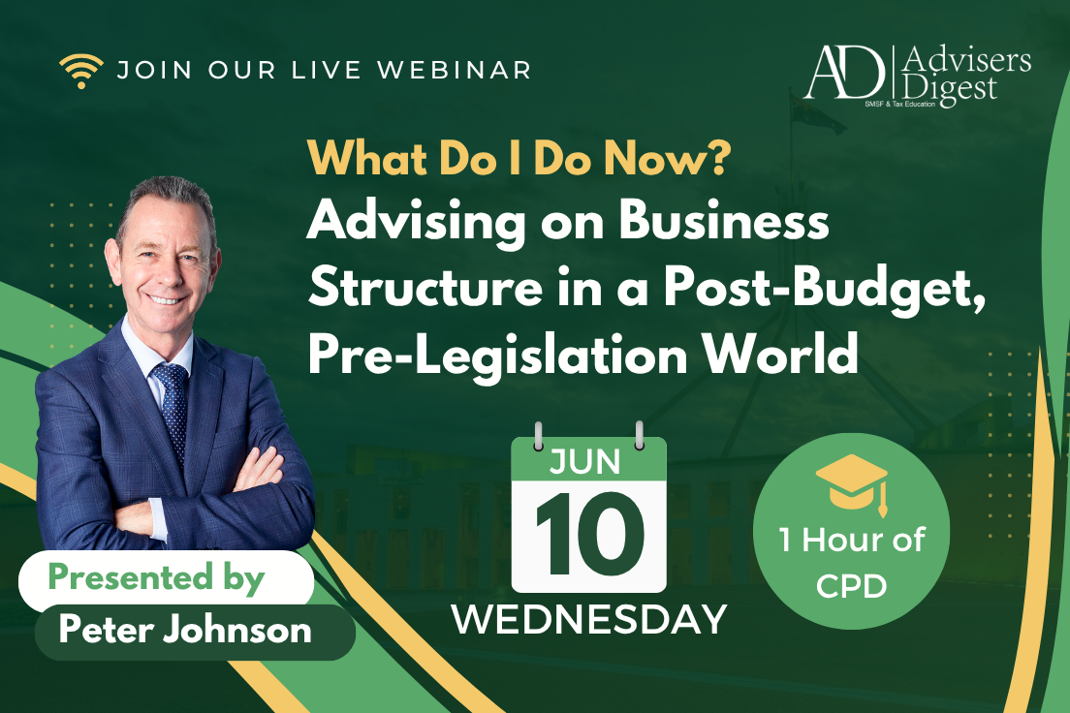
26
LAUNCH SPECIAL · ACT NOW
What Do I Do Now? Advising on Business Structure in a Post-Budget, Pre-Legislation World
WHAT WE'LL COVER
Why the company vs trust decision has changed — and why the old default no longer works.
$
The zero cost base issue, and how it changes CGT outcomes from 1 July 2027.
Live Session Only
How the trust minimum tax impacts income splitting — with worked examples.
Whether discretionary trusts now make more sense as company shareholders.
LIVE + RECODING BUNDLE
The corporate beneficiary double-tax risk, and why caution is needed.
How to give clients defensible advice before the legislation is finalised.
A live decision tree covering structure choices across different client scenarios.
PRESENTED BY
1
Peter Johnson
HOUR OF CPD
The Missing Link In Tax Planning · May 2026
12 – 1 PM, Wednesday, 10 June 2026 (AEST)
© 2026 BVO · AdvisersDigest.com.au

Slide 25
26
LAUNCH SPECIAL · ACT NOW
Book Now — Limited Time Only.
Two ways to attend. Price goes up next Wednesday.
LIVE + RECORDING BUNDLE
LAUNCH SPECIAL
$
159
129
$
Live Session Only
Live & On-Demand Access
Wed 10 June 2026 · 12–1 PM AEST · 1 hour of CPD.
Watch live or catch up later — full recording included.
Price goes up next Wednesday · Don't miss out.
The Missing Link In Tax Planning · May 2026
© 2026 BVO · AdvisersDigest.com.au

Slide 26
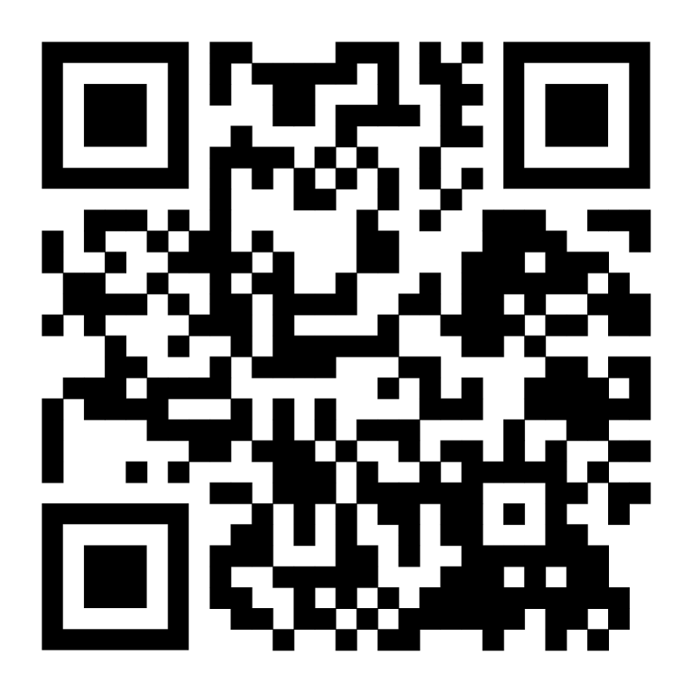


27
SIGN UP TODAY
Scan To
Sign Up.
What Do I Do Now? — Advising on Business Structure in a Post-Budget, Pre-Legislation World.
Wednesday, 10 June 2026 · 12–1 PM AEST
▲ SCAN TO SIGN UP
1 Hour of CPD · Live + Recording from $129
The Missing Link In Tax Planning · May 2026
© 2026 BVO · AdvisersDigest.com.au

Slide 27
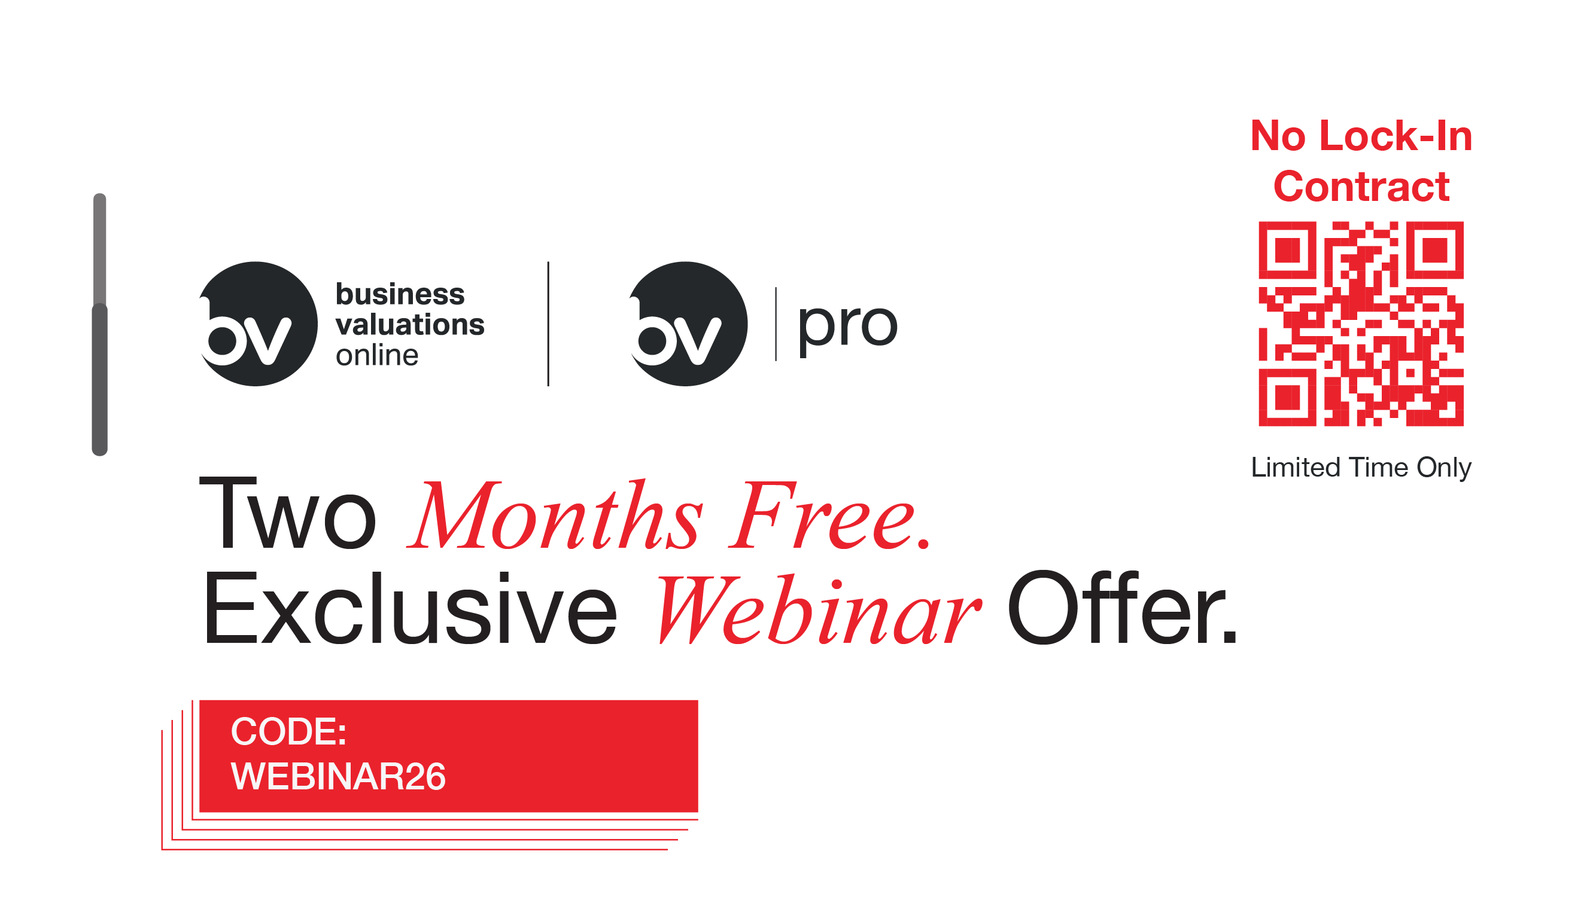
25
PROMO CODE
WEBINAR26
The Missing Link In Tax Planning · May 2026
© 2026 BVO · AdvisersDigest.com.au

Slide 28
Question
Time
BVO × ADVISERS DIGEST · Q&A

Slide 29



26
STAY IN TOUCH
Connect With Me.
Peter Johnson
Advisers Digest · BVO
Tax, structuring & valuation guidance, every month.
Webinars, technical updates and worked examples in your inbox.
Direct line to
continue the conversation
from today's session.
LINKEDIN
linkedin.com/in/smsfexpert
SCAN TO CONNECT
The Missing Link In Tax Planning · May 2026
© 2026 BVO · AdvisersDigest.com.au

Slide 30

27
Thank You.
E.
info@businessvals.com.au
W.
businessvaluations.online · bvopro.online · bvo.ai Coming Soon
P.
1300 2VALUE
The Missing Link In Tax Planning · May 2026
© 2026 BVO · AdvisersDigest.com.au

