Slide 1





Ready Set Sell:
Preparing A Business
For A Winning Exit
Exiting a business isn’t just about selling – it’s about navigating the right path for the best outcome.
Notes:
Exit plans and Business plans are the same thing. A good business plan should include the bones of an exit plan and should be updated as the owner gets closer to exit… A business plan is, after all, a living, evolving document that is there to assist the leadership by providing a structured approach to how the business grows, trades, scales, and exits (amongst other things).
So today, we will be chatting about the exit planning piece of that puzzle – specifically, how building an exit plan can make all the difference to your client.
There are very few exits that I have ever seen that did not benefit from some level of planning before the transaction. Whether we have three months, or ten years, there are benefits to be had. Whether that be optimal structuring for the transaction to minimize the tax paid on the event by the beneficial owner, maximising the profit made by the business, reducing risks, increasing value, or targeting specific buyers/groups so as to create urgency and a bidding war between competing parties… The plan is a strategic approach to leaving the business.

Slide 2




Exit Planning As A Map
Understanding Your
Current Position
01
Market Position
How does your business compare to competitors?
Exit planning begins with knowing where you are – just like finding your location on a map.
02
Financial Health
Is your business strong enough to sell?
03
Owner Reliance
Can it run without you?
Notes:
Most business owners are going to have a pretty solid idea of where they'd like to arrive (and how!) – with a bag of cash, in a limo, and a stress free exit. But like any navigation, it simply isnt possible to know how to get to your desired endpoint without first understanding where you are starting. Otherwise, you are simply aimlessly wandering without ever knowing if you are headed in the right direction. And your destination, may end up looking very different to the one you wanted.
If you were in downtown Sydney and you asked your phone for directions, it can only guide you because it knows exactly where you are. If you knew you wanted to get to Central Station, but had no idea where you were starting out, you are going to have to wander aimlessly until you work out where you are, so that you can now formulate your plan. It is no different in business.

Slide 3



Exit Planning As A Map
Understanding Your
Current Position
01
Market Position
How does your business compare to competitors?
The clearer your starting point, the better your exit strategy.
02
Financial Health
Is your business strong enough to sell?
03
Owner Reliance
Can it run without you?
Notes:
Most business owners are going to have a pretty solid idea of where they'd like to arrive (and how!) – with a bag of cash, in a limo, and a stress free exit. But like any navigation, it simply isnt possible to know how to get to your desired endpoint without first understanding where you are starting. If you were in downtown Sydney and you asked your phone for directions, it can only guide you because it knows exactly where you are. If you knew you wanted to get to Central Station, but had no idea where you were starting out, you are going to have to wander aimlessly until you work out where you are, so that you can now formulate your plan. You may even wander around until you run out of time and simply have to accept that Redfern will have to do. It is no different in business. Except you, as the accountant, are the ‘local’, who can swiftly assist the wanderer work out where they are at and give them the directions they need. You are google maps!
So the first step of any effective exit plan is to understand where you are beginning your journey. It tells us a lot. How much effort is going to be needed to get there? How far do we need to come? Do we have the time? Do we have the resources?
The first steps are always understanding your business compared to the rest of the market. Understanding how your business performance compares (benchmarking). And How reliant the business is on the owner. Ie. How transferrable the business is.

Slide 4







Finding Your Starting Point
Risk Assessment
Conducting A
Comprehensive
Business Valuation
What threats could lower value?
Competitive Analysis
How do you stand out in the market?
Operational Efficiency
Are systems in place to run smoothly?
Not all valuations are the same. A strong valuation should could include:
Growth Potential
How attractive is your business to buyers?
Impact Analysis
What influences value?
Business Value Assessment
Understand the business value drivers.
Notes:
The valuation is not an end in and of itself. It is a process that ought to let you understand what the business is currently worth and why. The WHY is the important part here. Once you can understand why your client’s business is worth what it is worth, you can go about building a tailored plan focused on improving that value. Is the business too reliant on the owner? Ok lets make a plan to address that. We are too reliant on one or two customers? Ok, lets see what we can do to address that. We are spending more than our competitors on salaries and wages? Why?
Risk assessment – what makes this business more or less risky than similar businesses. But also, how risky is their specific industry or sub industry? The idea is to understand the relative risk of this business to simply putting the money into a risk free (government bond), considering all other investment opportunities.
Competitive analysis – What makes this business stand out from the crowd? Is it their branding, their people, their unique world view, the systems and processes they have developed?
How efficient is the business? Many owners try to sell their business on what it could be. They are selling blue sky. A proper valuation is assessing the business as it currently operates, as a going concern. Not the rosy picture of the future that the new purchaser could potentially achieve. It isn’t, as some of my colleagues might call it, based on a ‘counter factual’ basis.
Has the business been growing? Contracting Shrinking? Is their industry in growth phase, mature, or contracting? Ie. What further upside is left in the business and industry?
Consider what moves the needle. What affects value in the business the most, and what controls exist to ensure that this isn’t going to be a negative, and what systems exist to help capitalise on the upside?
All of these influence the multiple or discount rather than the profit.
Profit is important. And going forward, maximising profit and cleaning up the financial statements needs to be a priority… But talking to a virtual room predominantly full of accountants and brokers, that’s a no brainer.

Slide 5





Audience Question
Key Business
Value Drivers
Automating Key Processes
What do you think makes a business more valuable?
Reducing Owner Dependency
Strengthening Management Teams
Diversifying Income Streams
Notes:
In my experience, the big stuff that really influences the value of an SME are the following. You will see that these are all about risks. By automating key processes, or at the very least documenting them, any potential purchaser need not worry about the key processes falling in a heap on their watch. Similarly, if the business is entirely reliant upon the current owner, the risk of the business failing skyrockets when it is transferred to a new purchaser and the old one walks out the door. How do we address that? Well – strengthern your management team. If there is no management team, consider the incremental delegation of key duties from the owner to key employees over time.
Diversification of income streams is simply good business. It reduces the overall risk burden of the business, because the risk of losing two income streams is lower than losing one. Structuring those streams is also critical – separate entities, separating IP, assets, people, and the trading business is optimum… so that if one stream goes bad, like a gangrenous limb, it can be lopped off without killing the whole business. Of course it is a trade off – operational efficiency can be really affected if you create too much admin.

Slide 6


Choosing Your Path
Knowing When To Sell,
Merge or Walk Away.
Not all businesses should be sold – sometimes, walking away is the best option.
Family Succession: Passing the business to heirs.
Internal Sale: Selling to employees or management.
External Sale: Finding an investor or buyer.
Synergistic Exit: Merging with another business.
The right exit plan secures value, protects your legacy, and ensure a smooth transition.

Slide 7
Setting The Exit Timeline
When & How To
Exit Successfully
The ideal exit timeline depends on:
Owners Goals: When do they want to leave?
Business Readiness: What improvements needs to be made?
Market Conditions: Is now the right time to sell?
Financial Planning: Will the exit meet financial needs?
A well-planned timeline maximises value and minimises stress.
Notes:
So knowing what the business is worth, knowing the specific risks and financial metrics that impact its valuation is the first half of the equation. Now we need to develop a plan, or plot that path (if we stick with the map metaphor!) to a successful exit.

Slide 8




Owner Commitment
Setting Achievable Goals
How much can the owner handle?
Capacity For Action
What can realistically be done before the exit?
Commitment Level
Is the owner fully engaged?
Resources And Support
Are accountants, advisers, and a transition team in place?
A business exit takes time – set realistic expectations and secure the right support.
Notes:
Also timeframe may raise its head here. Many business owners decide they are ready to sell without having prepared at all. Or they are approached out of the blue... its likely they will not have an optimum outcome. OF course, a business that is always ready to sell will always get the best result, but these businesses are rare beasts indeed. But that is whatbusiness plans are all about. A good business plan will usually mean the business is prepared!

Slide 9


The Exit Plan
A Step-by-Step Strategy
For Success
01
Structure
Tailored to the owner’s goals and budget.
A well-executed exit needs:
02
Flexibility
Adaptable to changing market conditions.
03
Actionable Steps
Small tasks that move the process forward.
Notes:
Also timeframe may raise its head here. Many business owners decide they are ready to sell without having prepared at all. Or they are approached out of the blue... its likely they will not have an optimum outcome. OF course, a business that is always ready to sell will always get the best result, but these businesses are rare beasts indeed.

Slide 10
Reality Checks
Tracking Progress &
Adjusting the Plan
Regular reviews keep the exit on track:
Annual Valuation Reviews: Measure business growth and financial health.
Adjustment Based on Market Shifts: Adapt to new conditions.
Reassess Exit Goals: Could an earlier exit be more profitable?
A successful journey requires regular checkpoints and course adjustments.

Slide 11



Financial & Legal Considerations
What To Consider
Before Exiting?
Tax Implications
What are the business and personal tax consequences?
Business Structure
Does being a sole trader, trust, or company affect the sale?
Capital Gains Tax (CGT) Concessions
What tax relief options exist?
Asset & Compliance Readiness
Are all financials and records up to date?
Proactive planning ensures a smooth transition and maximises financial outcomes.
Notes:
Conversations with business owners are critical. If you are the business owner and youd like to sell in the next 5 years, you should be asking questions of your accountant about these things. Perhaps there are restructuring opportunities that will help you personally achieve the best financial outcome. CGT concessions may see you save up to a million dollars in tax payable. But this needs to be considered three years in advance. But there are a million reasons why this is simply good practice.
Keeping a tight ship is critical to the best exit outcome.

Slide 12


The Final Destination
Are You Ready To Begin
Your Exit Journey?
Where are you on the business roadmap?
What’s your exit strategy?
Do you have the right team?
The lower your business risks, the more valuable it becomes.

Slide 13
Some First Steps
Key Factors That
Influence Business Value
Reduce Owner Dependency: Ensure the business can operate independently with a strong management team and clear operational system.
Premises & Lease: Is this location critical to the business’s success?
Suppliers & Clients: Are you overly reliant on one supplier or client?
Systems & Documentation: Are processes structured and documented?
Business Plan: Is there a clear strategy for future growth
Notes:
A few things you can start tomorrow to improve your valuation.

Slide 14
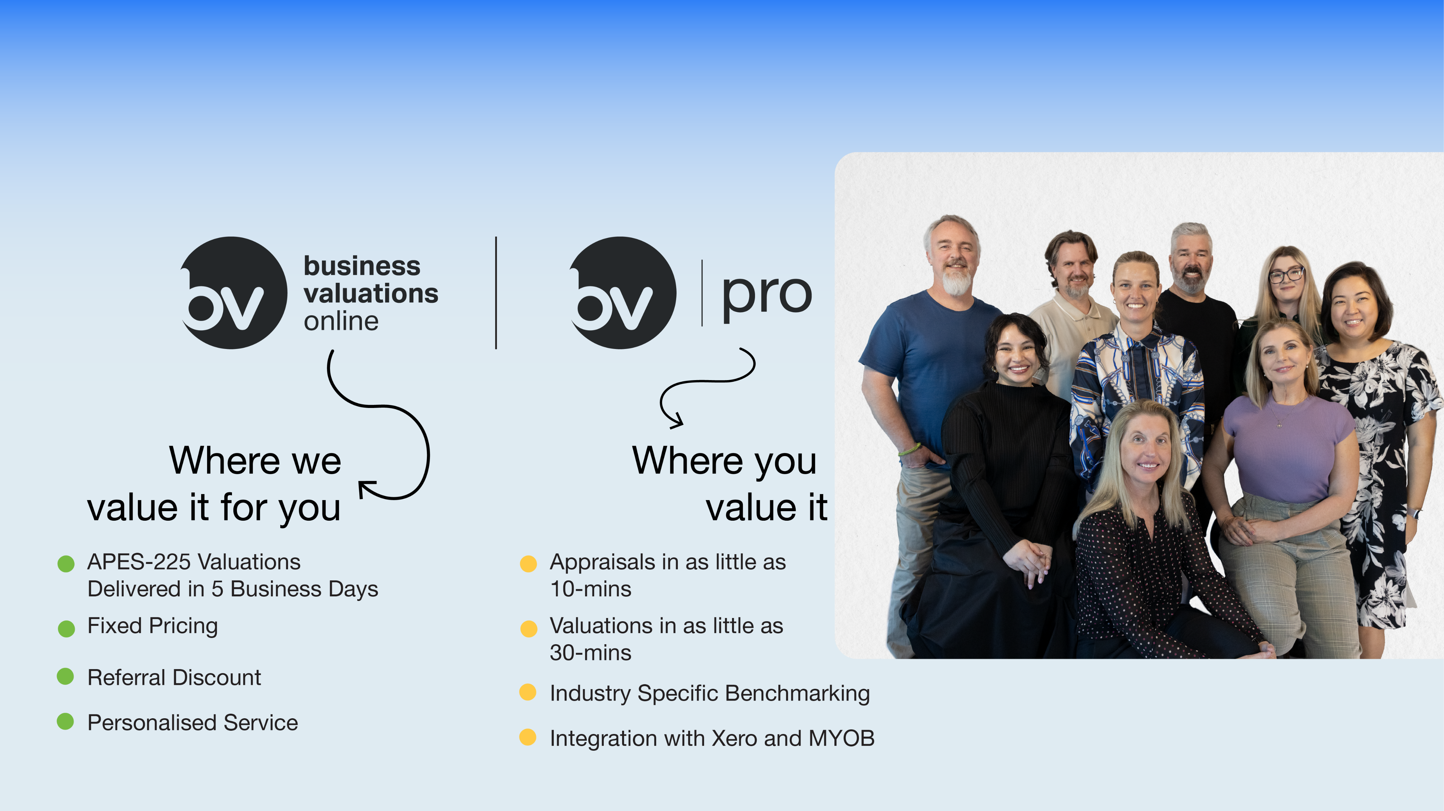

Slide 15
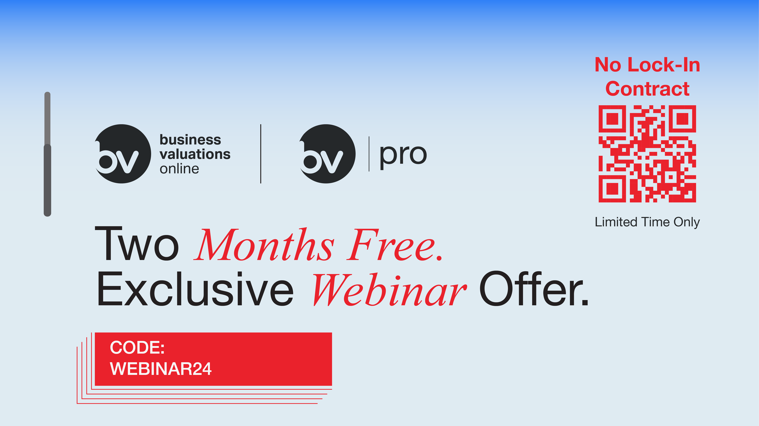

Slide 16


